Slide 1

Welcome to Our Presentation

Slide 2
BIG DATA ANALYTICS USING HADOOP ECOSYSTEM
Md. Nakibul Hassan ID : 132-15-2711
Md. Aminul Islam ID : 132-15-2704
Farid Or Rashid ID : 122-15-1981
Md. Sadekur Rahman
Senior Lecturer
Department of CSE
Daffodil International University

Slide 3
Content
Introduction
What is Big Data?
Four V’s of Big Data
Motivation
Objective
Hadoop as Big Data Framework
Hadoop Feature
Technology Used
Hardware Specification
Work Flow
Data set
Implementation
Future Scope
Conclusion

Slide 4
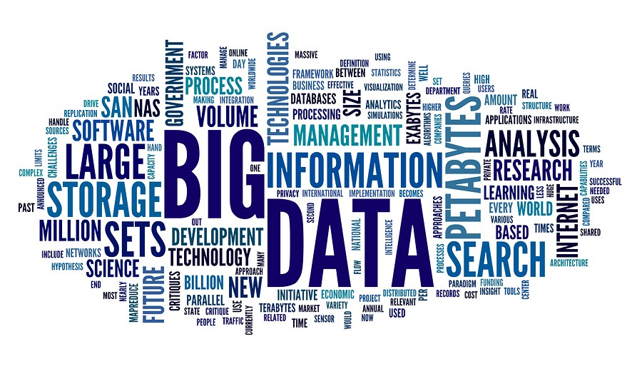
Introduction

Slide 5
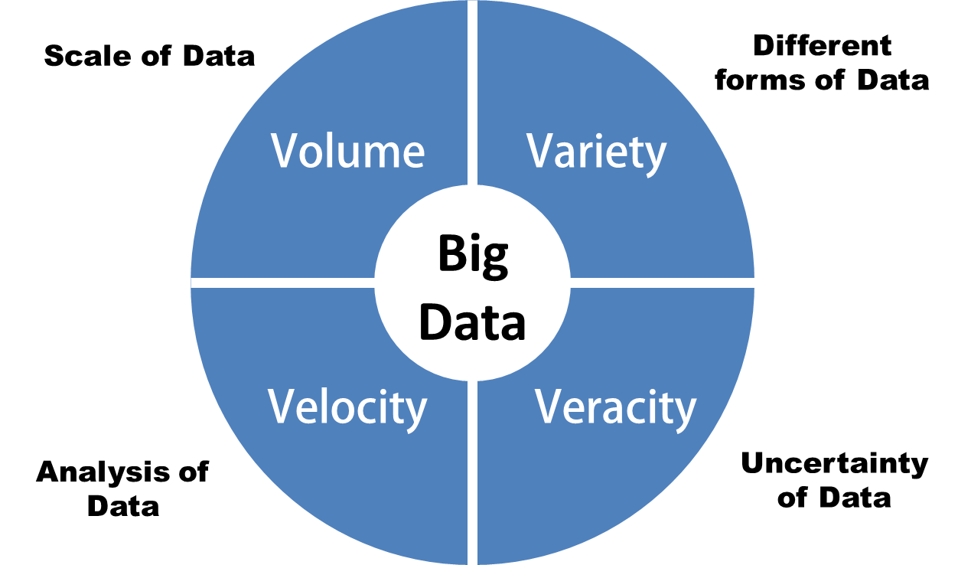
What is Big Data?
“Big data are high volume, high velocity, and high variety information assets that require new forms of processing to enable enhanced decision making, insight discovery and process optimization” (Gartner 2012)

Slide 6
Four V’s of Big Data
Volume – exceeds limits of traditional column and row relational DB and constantly growing data
Velocity - arrives rapidly, often in real time
Varity - does not have a standard structure, e.g. text, images
Veracity- uncertainty of data

Slide 7
Motivation
One of the top trending technology in 2015
All the large tech company like Google, Facebook, Amazon using Big Data analytics
In 2012, White House announced $200 million on Big Data Project
Traditional RDBMS is not sufficient to handle big data.
Business Organization’s use Big Data analytics to get better predictive analysis.

Slide 8
Objectives
To deeply learn about Big data and its nature .
To learn most popular Big data framework Hadoop.
To learn Hadoop ecosystem and how they work
To learn how to handle large data and apply different analytical job on top of them using Hadoop ecosystem

Slide 9
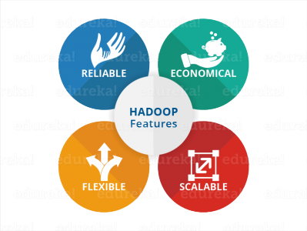
Hadoop As Big Data Framework

Slide 10
Hadoop Features
Flexibility – ability to deal with all kinds of data
Reliability – works as fault tolerance fashion
Economical – uses commodity hardware
Scalability – ability to expand setup

Slide 11
Technology Used
Hadoop
Map Reduce
Pig Compiler
Pig Latin

Slide 12
Hardware Specification
4 GB of RAM or Above
20 GB of Free space
Dual core processor or above

Slide 13
Work Flow
Install Hadoop
Install Pig
Load data into HDFS
Enter into Pig Grunt Shell
Visualize Output
Store Output into the HDFS
Run Pig Script on Top of data set
Load data using Pig

Slide 14
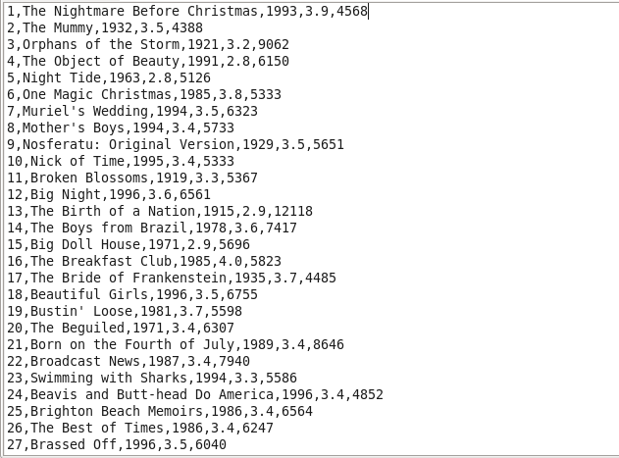
Data Set
We used a movie data set

Slide 15
Implementation
We analysed our data depending on various use cases
First use case is show movie list and year of released between 1950 to 1960
We used Pig Latin as a Programming framework.

Slide 16
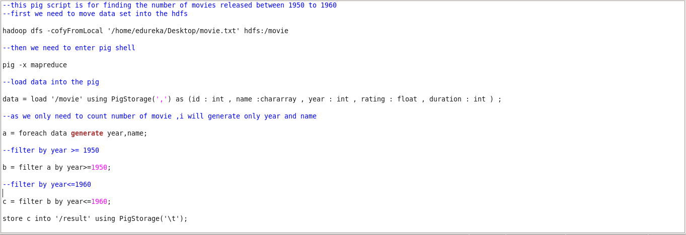
Implementation
Below figure show the Pig Script

Slide 17
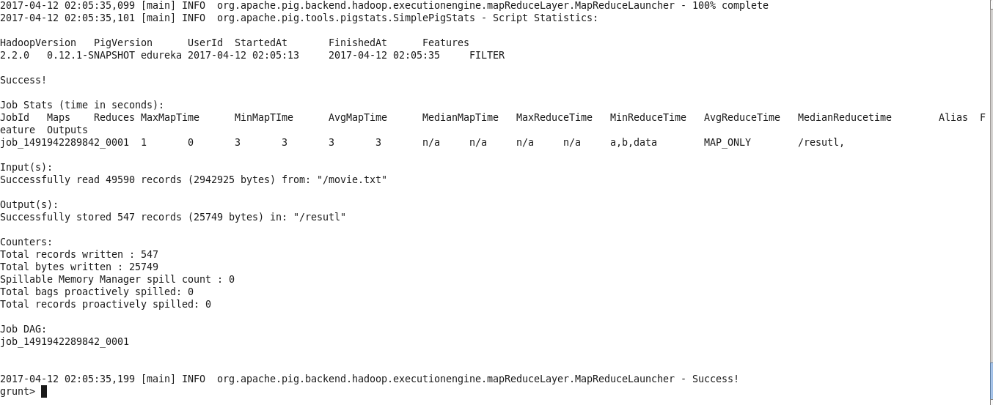
Implementation

Slide 18
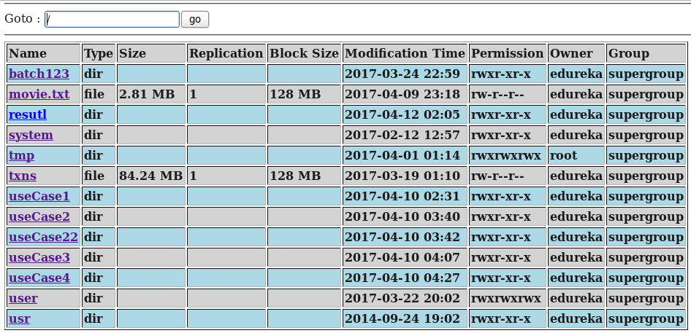
Implementation

Slide 19
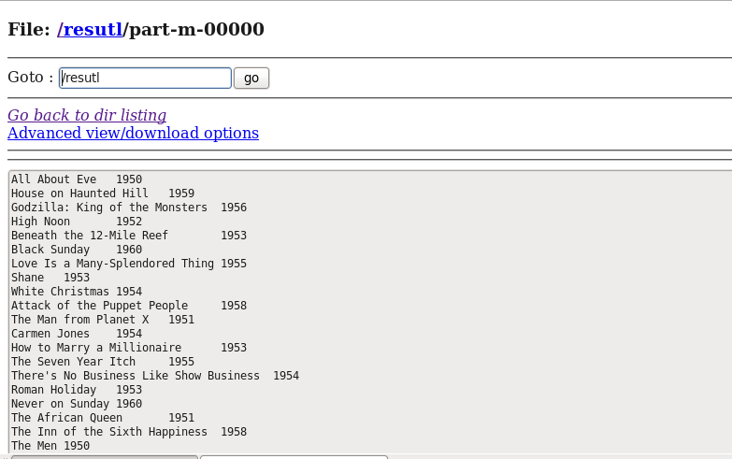
Implementation

Slide 20
Future Scope
As we used single node cluster in our project, in future we will use multi node cluster
In our project we use CSV format data, In future we will work with complex data set like JSON format or streaming data

Slide 21
Conclusion
After completing this project we learnt lot about Big Data and Hadoop. We also learn about Hadoop Ecosystem and which tools is suitable for which format of data set. By doing this project we are one step ahead of learning new technology.

Slide 22
Thank You

